Slide 1
Scatterchron:
Visualizing Language Change in Diachronic Corpora
Jason S. Kessler || Using and Developing Software for Keyness Analysis || February 27, 2023

Slide 2
Introduction
Why would we like to visualize how language changes over time?
Temporal. News alerts are ordered by date.
Create a timeline of events over a year.
Sequential. Chapters or pages in a novel.
Visually represent the plot and presence of characters.
Product review data. Reviews are ordered by star rating.
See what features or issues are in different rating regions.

Slide 3
Outline
Related work in visualizing language change over time
Interactive text visualizations with Scattertext
Binary difference: term frequencies before and after time-change
Most associated terms in each time step.
Clustering time steps to make them more manageable
Detecting terms that clump together at different time steps or are more dispersed
Average time position

Slide 4
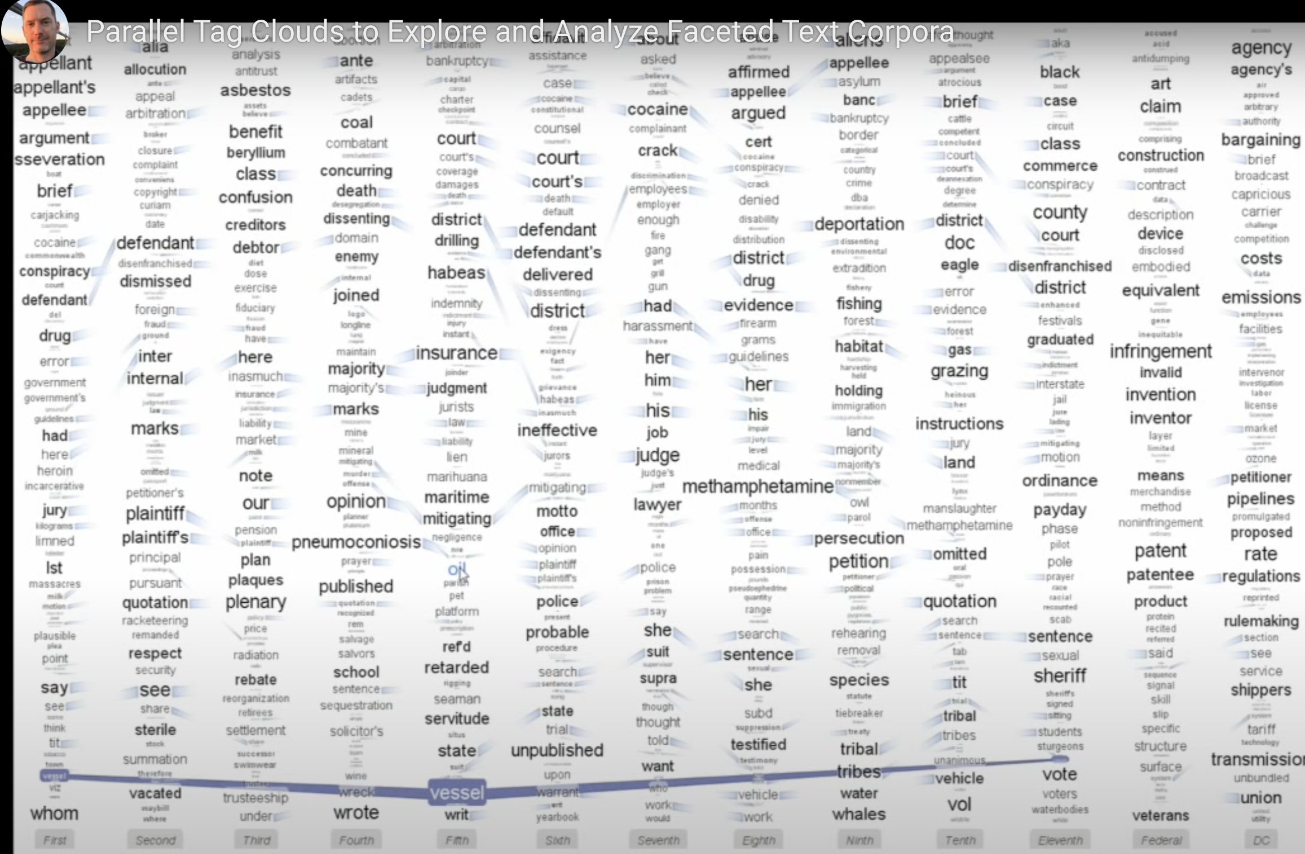
Related Work
Parallel Tag Clouds
Key terms are vertically arranged at each time step
Size indicates time-step association (G²)
Order is alphabetical
Connectors to the same words appearing in different time steps
C. Collins, F. B. Viégas, and M. Wattenberg. 2009. Parallel Tag Clouds to Explore and Analyze Facted Text Corpora. VAST.

Slide 5
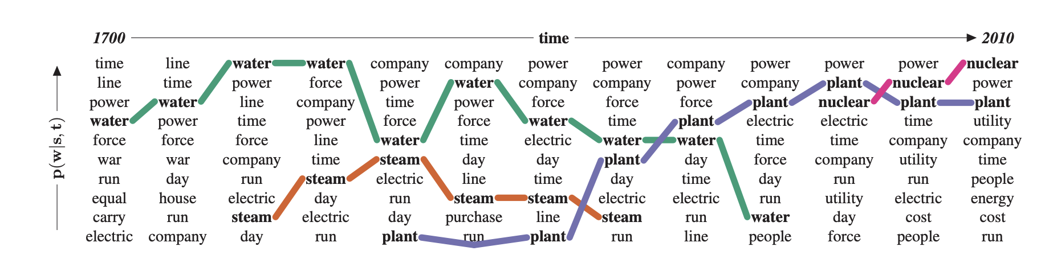
Related Work
“Words most associated with the energy-sense of the word ‘power’”
Influenced by Parallel Tag Clouds
More readable layout
Ordered by association, not alphabetically
Lea Frermann and Mirella Lapata. A Bayesian Model of Diachronic Meaning Change. TACL 2016.

Slide 6
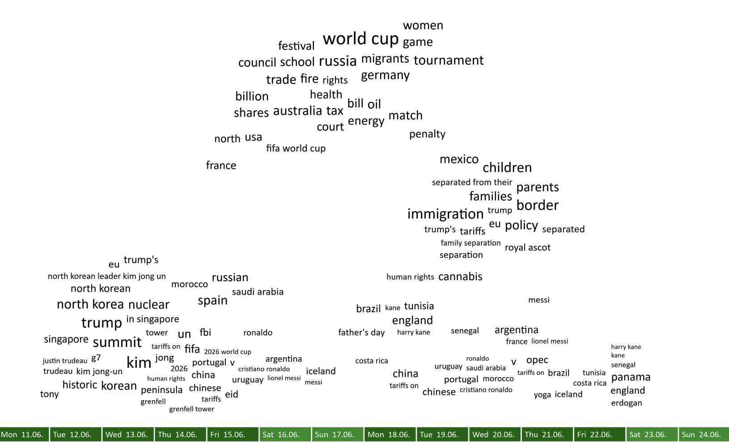
Related Work
PyramidTags
N-grams are displayed in a “cloud” above a timeline.
Horizontal position: roughly mean point in the timeline
Vertical: higher up indicates longer time-span
Arranged s.t. words, even when not in phrases, tend to appear in sequence.
Similar terms cluster together
Knittel, J., Koch, S., & Ertl, T. 2021. PyramidTags: Context-, Time- and Word Order-Aware Tag Maps to Explore Large Document Collections. IEEE Transactions on Visualization and Computer Graphics.

Slide 7
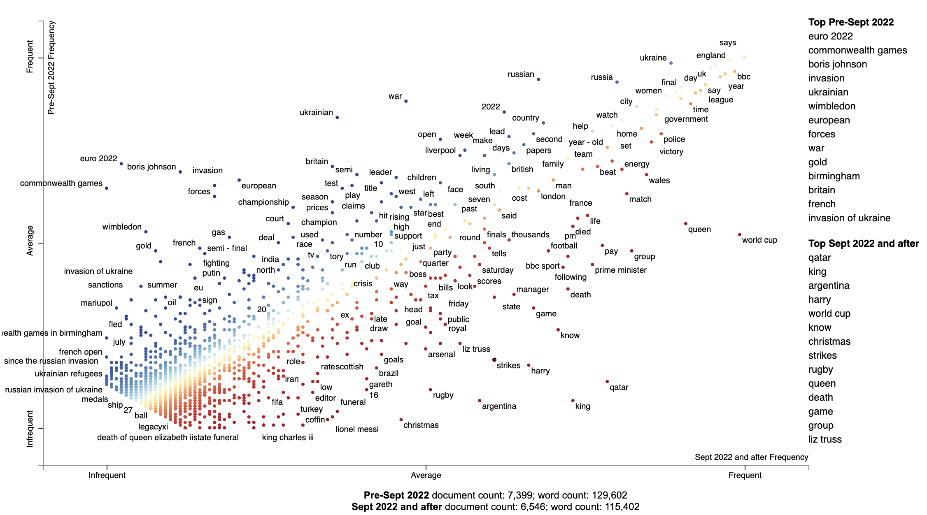
Time-step divided plot
BBC RSS feed corpus (Feb 2022 - Feb 2023)¹
13,945 alerts; 361 days; 281,589 words
Label each alert by before Sept 2022, Sept 2022 and after
Plot rank frequency of features on x-axis in <9/22 and of >9/22 on y-axis
Uses Scattertext (Kessler 2017)
Color by difference in ranked frequency
Jason S. Kessler. Scattertext: a Browser-Based Tool for Visualizing how Corpora Differ. ACL System Demonstrations. Vancouver, BC. 2017
1. kaggle.com/code/gpreda/bbc-news-rss-feeds

Slide 8
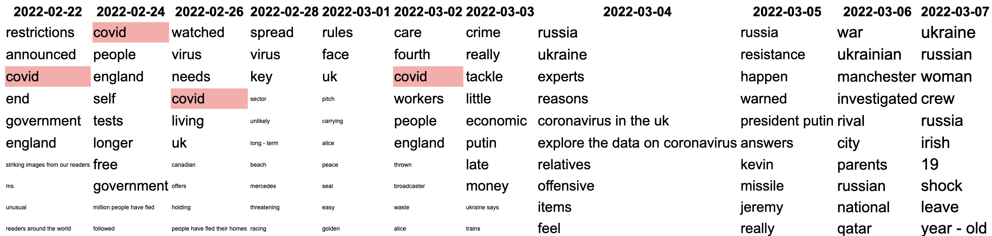
Parallel tag clouds
Displaying time-step information
“covid” is moused-over
Jenson Shannon Divergence is used as time-step association metric
Symmetric version of KL divergence
This approximates Cohen’s d well and is faster to calculate
Pechenick, E. A., Danforth, C. M., and Dodds, P. S. 2015. Characterizing the google books corpus: Strong limits to inferences of socio-cultural and linguistic evolution. PloS one, 10(10):e0137041.

Slide 9
Parallel tag clouds
Displaying time-step information
Size: frequency in class
Ordered by delta JSD
Problem:
there are 361 time steps; we can’t show them all without a lot of horizontal scrolling

Slide 10
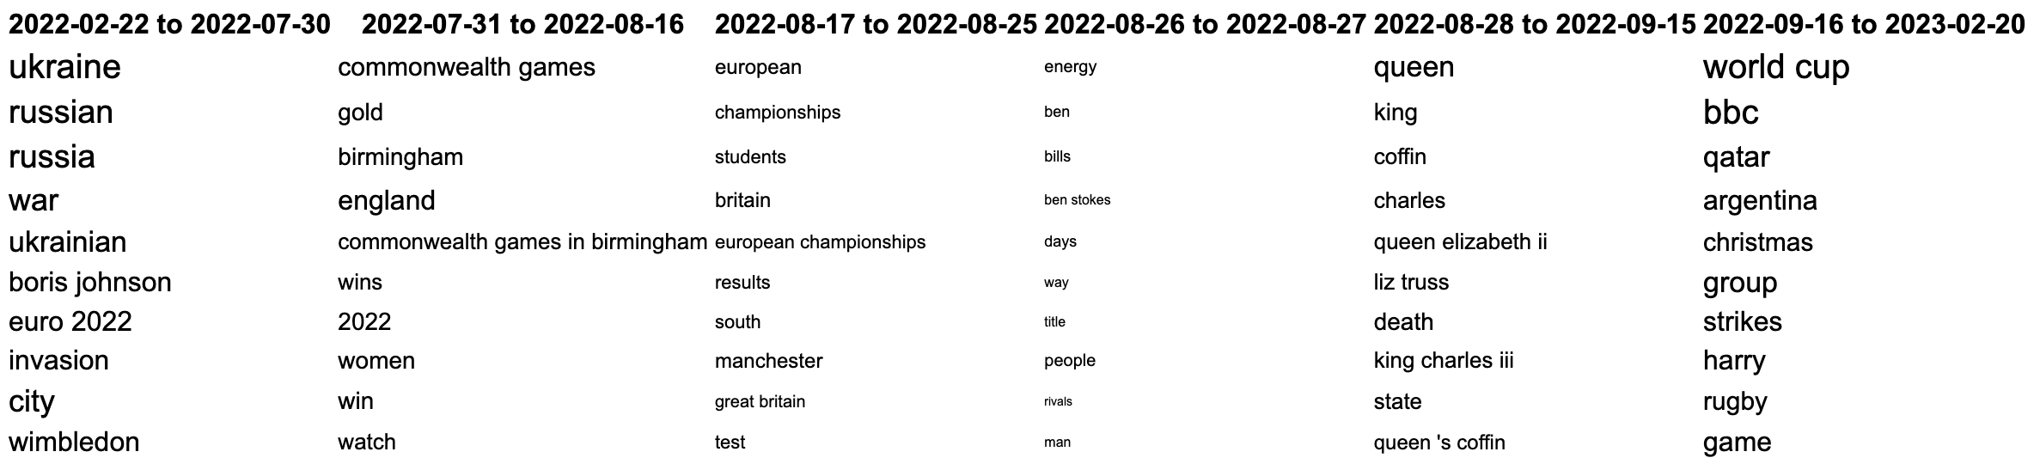
Clustered parallel tag clouds
Displaying time-step information compactly
Solution: create clusters of time steps
Among terms displayed, compute Spearman’s correlation coefficient on score ranks for adjacent time steps
Select the K (above K=5) lowest correlations for breakpoints

Slide 11
Plotting change over time: dispersion
Dispersion: metric which indicates if terms appear at the same frequency distributed across corpus parts (time steps) or if they occur with disproportionate frequency in some rather than others
Dispersion metric: DA (Burch et al., 2017)
Mean absolute pairwise difference between part frequencies
Ranges from 0 (a term only appears in one part) to 1 (same frequency in each part)
0.5: the average pairwise difference is the mean frequency
It takes O(time-steps²) to run. Gries’ DP, etc. are faster but lower quality.
Burch, B., Egbert, J., & Biber, D. 2017. Measuring and interpreting lexical dispersion in corpus linguistics. Journal of Research Design and Statistics in Linguistics and Communication Science

Slide 12
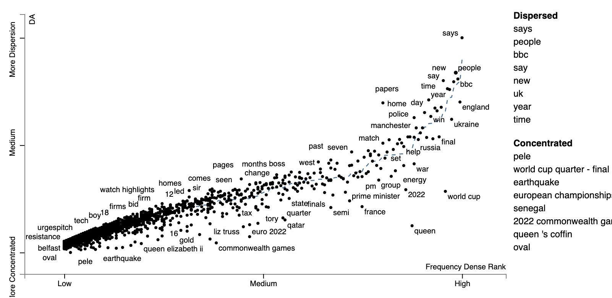
Plotting change over time: dispersion
High dispersion: general news term/high frequency
Low dispersion: specific story or topic
Blue line: a non-parametric estimate of dispersion from frequency (mean of bootstrapped isotonic regressions)

Slide 13
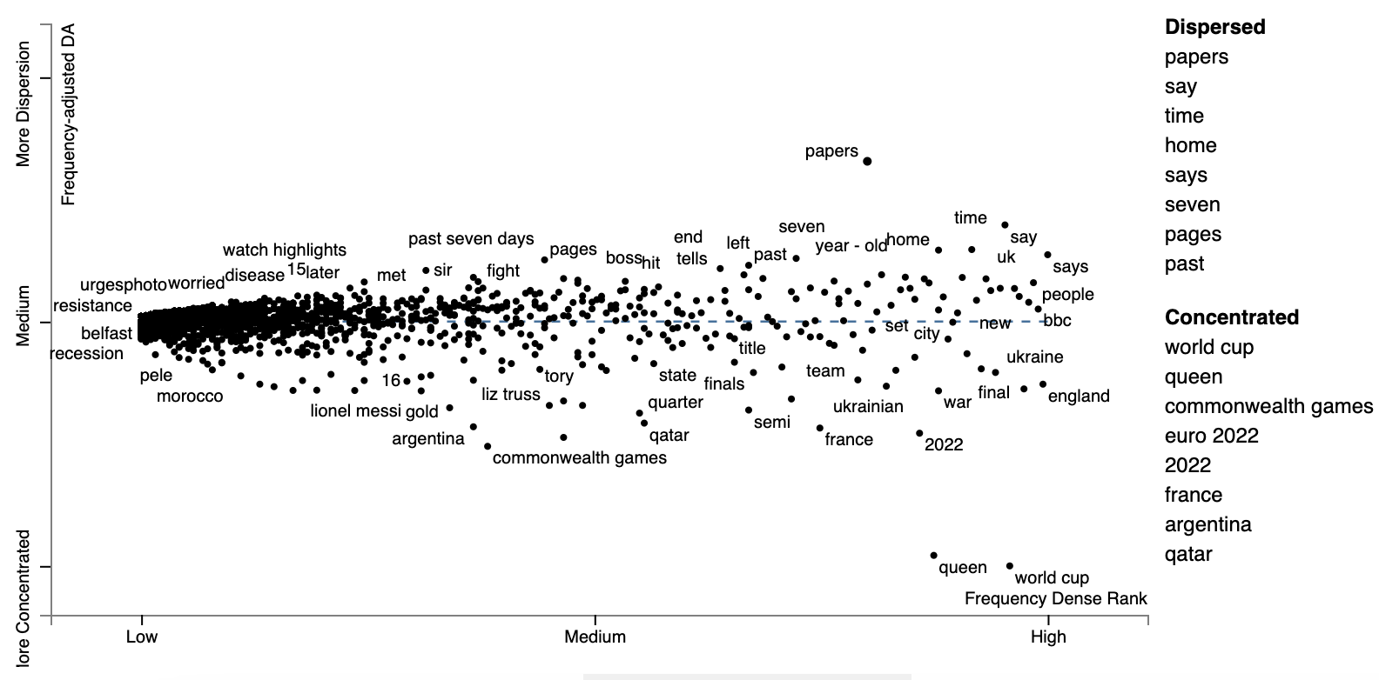
Residual DA: frequency normalization
Plot residuals from the non-parametric regression
Better isolates general vs. topical component of DA

Slide 14
Incorporating Average Position
Residual dispersion: what’s event-related or bursty vs. what’s more general
Missing: where on the timeline did the event occur
Solution: center terms on their average time steps, similar to PyramidTags

Slide 15
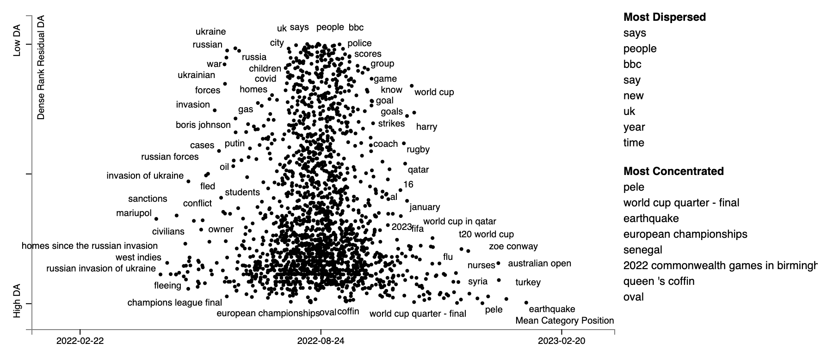
Incorporating Average Position

Slide 16
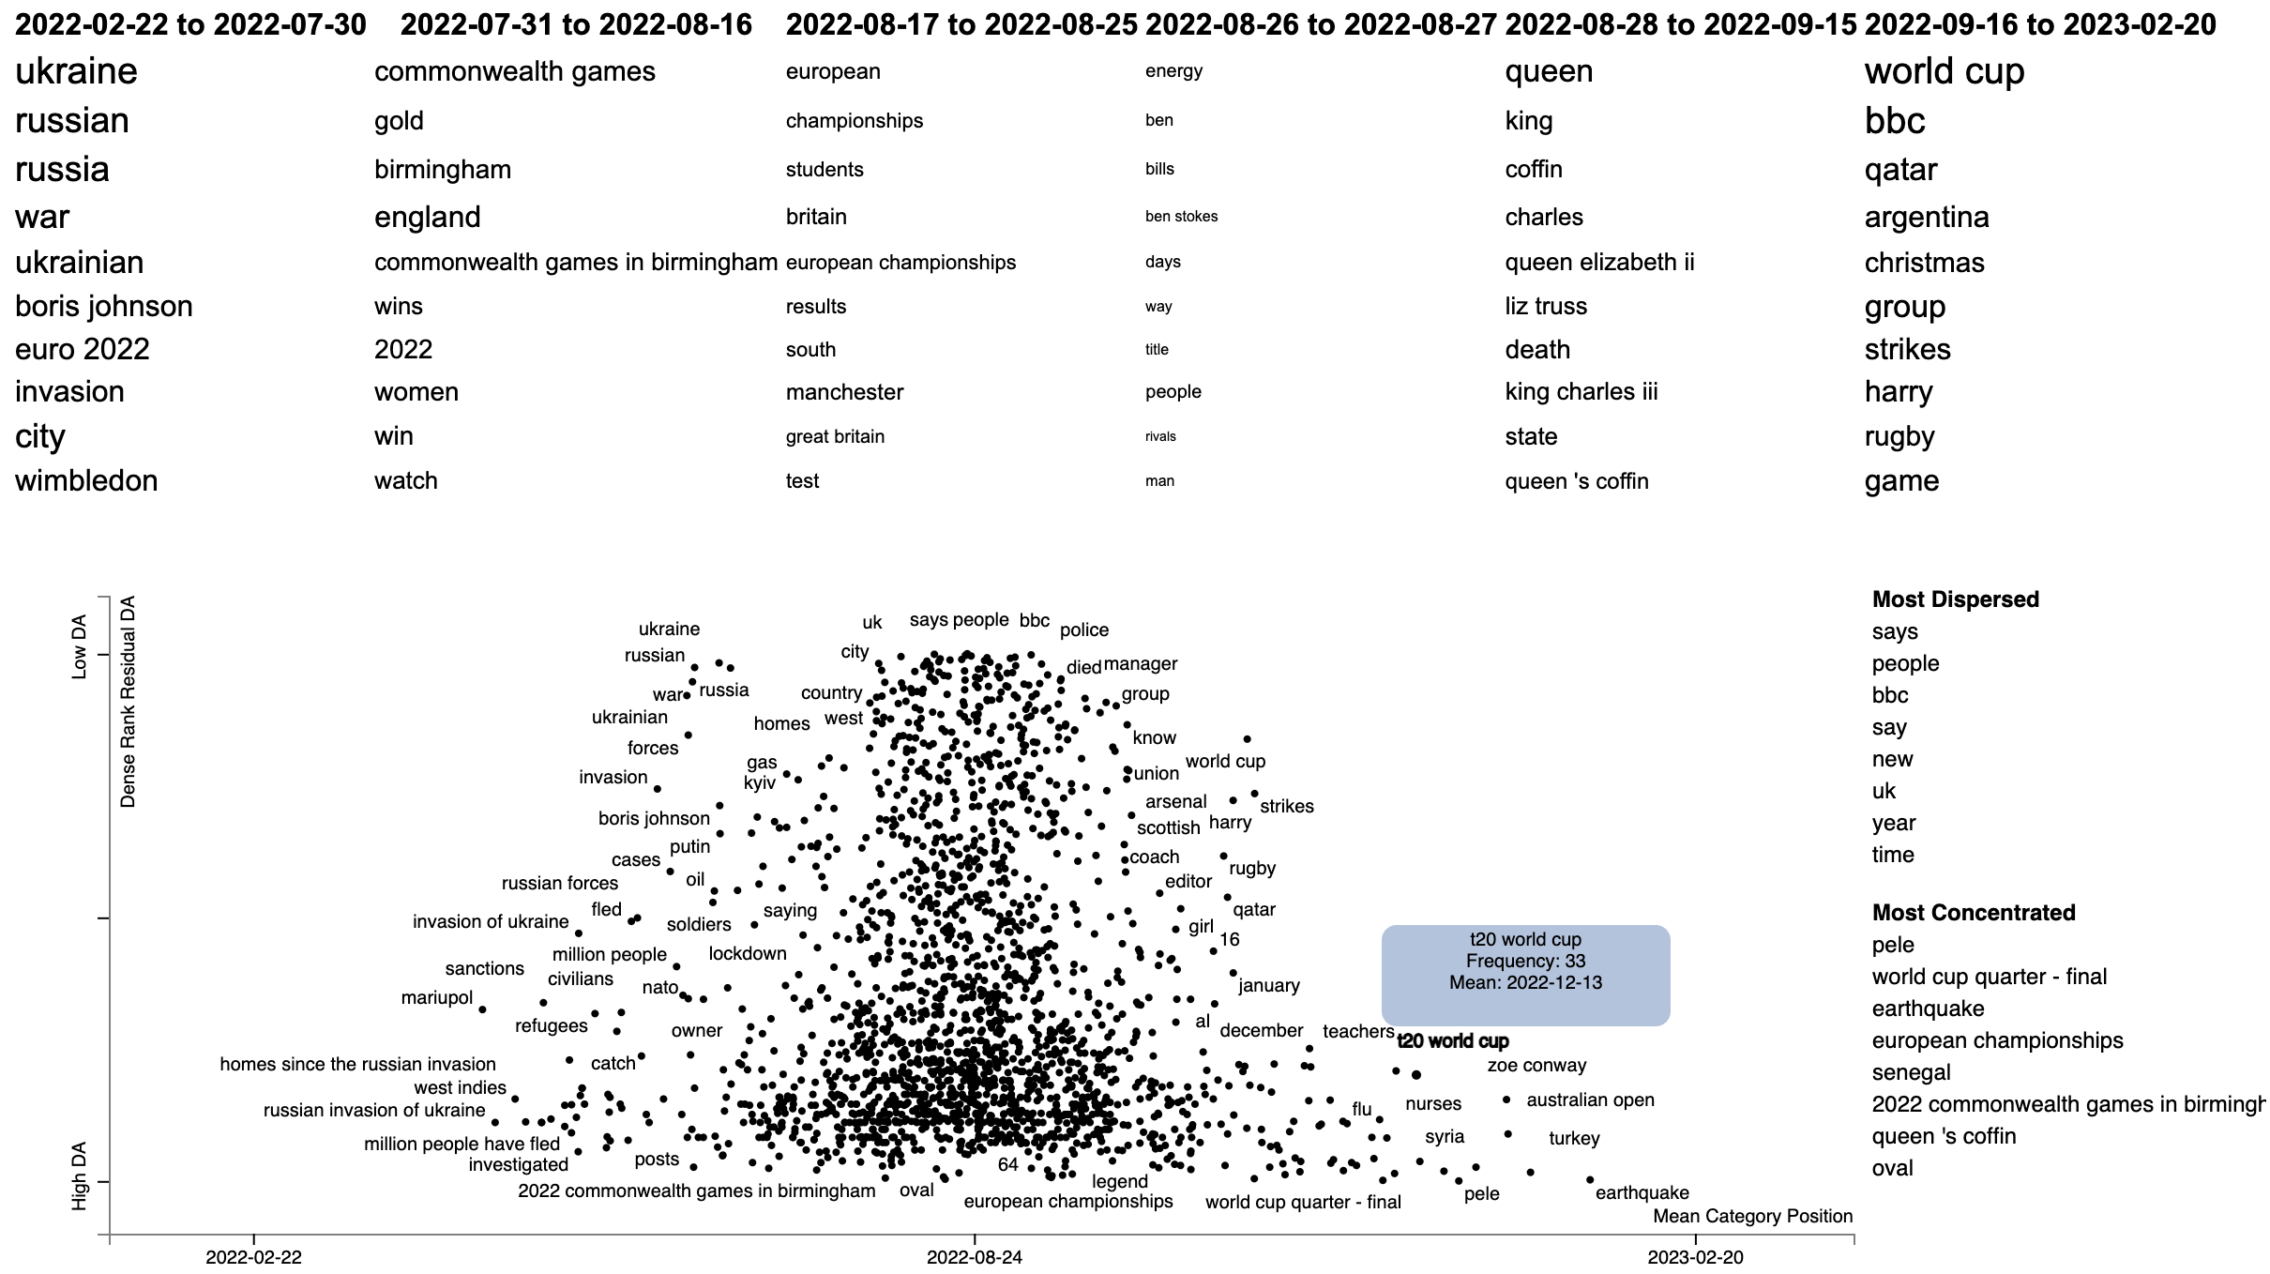
Stacking the visualizations gives the best of both worlds
Interactive Demo

Slide 17
Future work
Position-sensitive dispersion metrics
Ways of factoring out or calling out periodicity
Chart interactivity to show a time step-specific plot

Slide 18
Thank you! Any questions?

Slide 19
Phrase Selection
Take 1-5 grams, keeping those which
start and end with a content word
appear at least three times
keep the top 2000 highest NPMI phrases per phrase length in tokens
does not makeup at least 60% of a longer (token-wise) selected phrase
Select 2000 phrases for visualization by round-robin selection of the highest JSD association for each year
Jenson-Shanon Divergence tends to favor topical but high-frequency terms

Slide 20
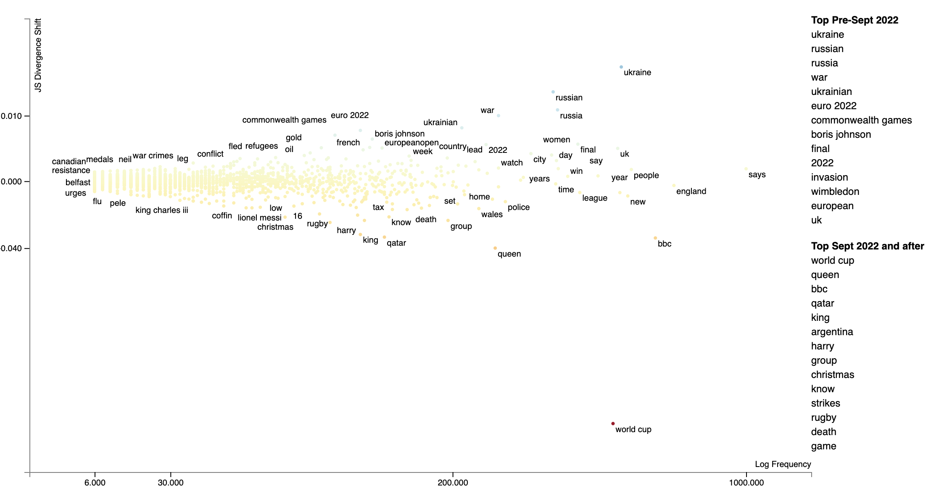
Delta JS Divergence
For a timestep si ∈ S;
ΔJSDterm = KLD(P(term|si)||P(term|S)) - KLD(P(term|~si)||P(term|Si))

Slide 21
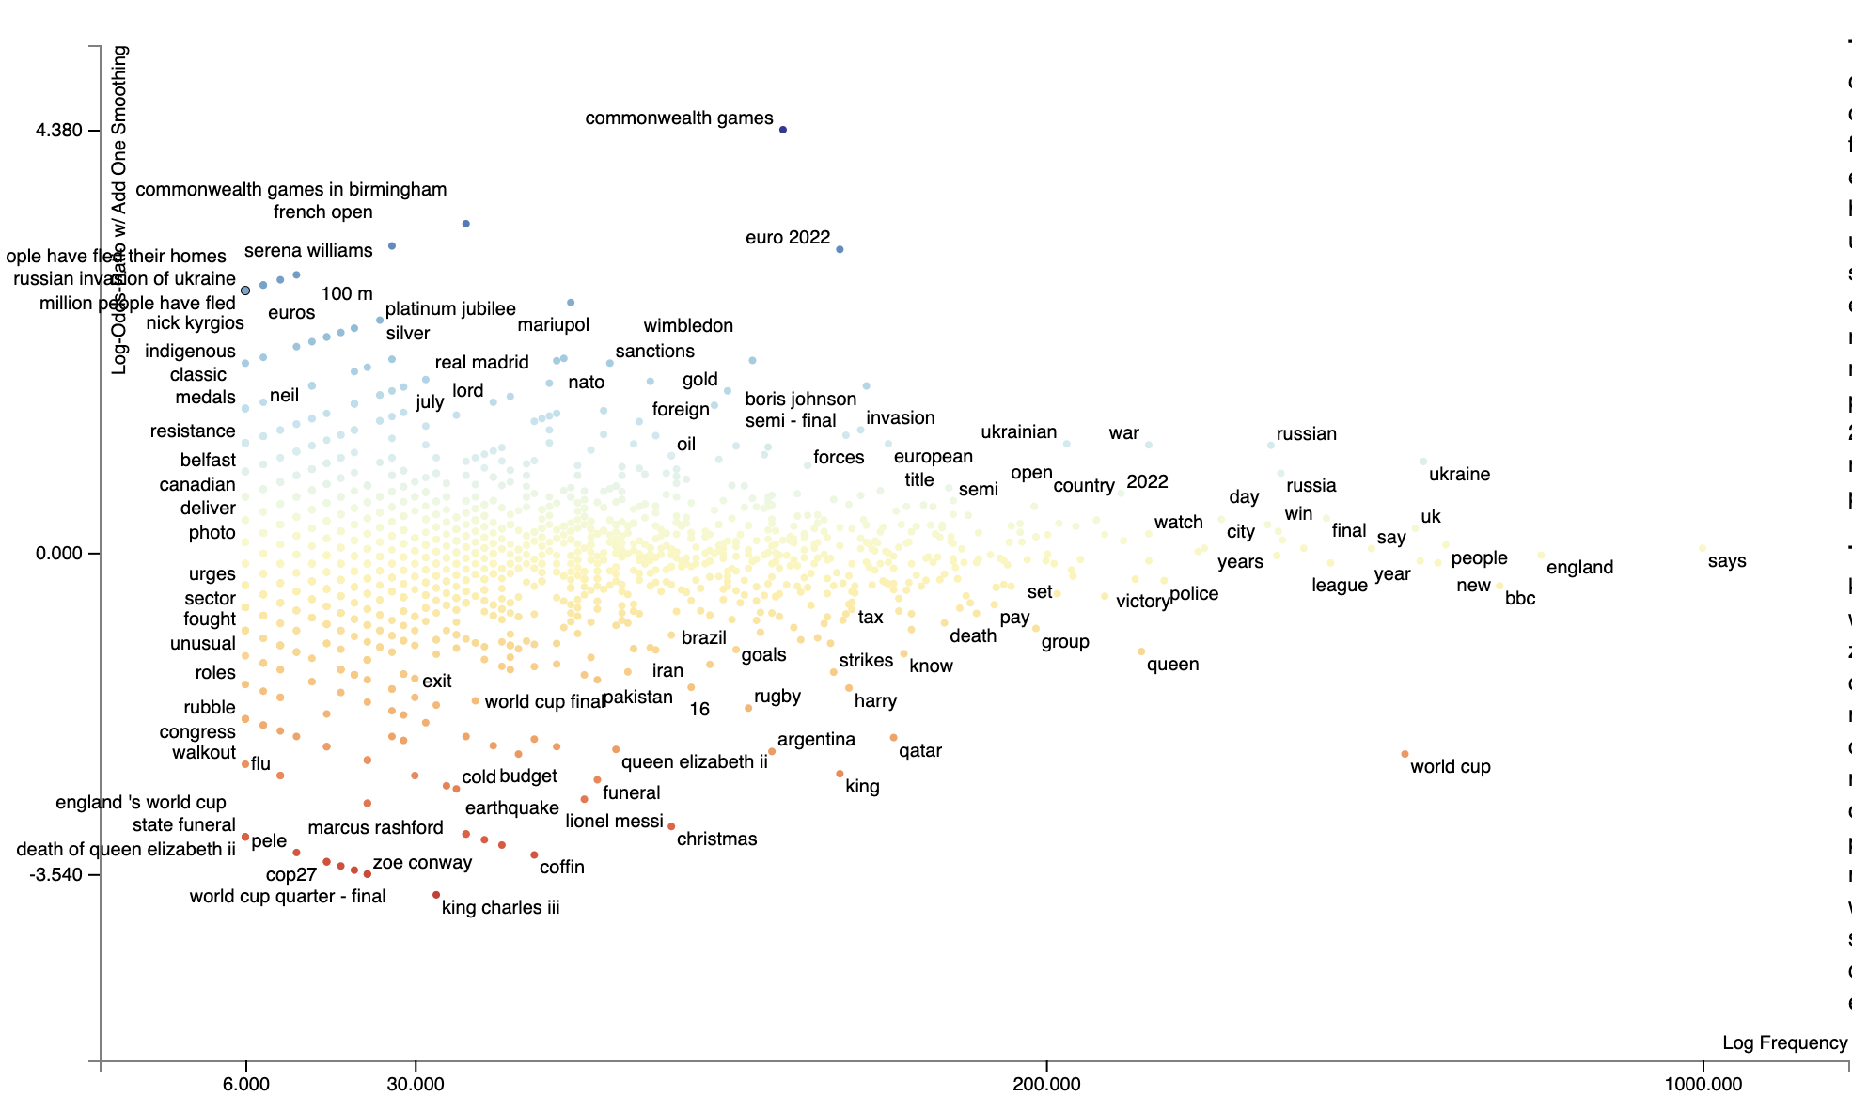
C/f log odds ratio

Slide 22
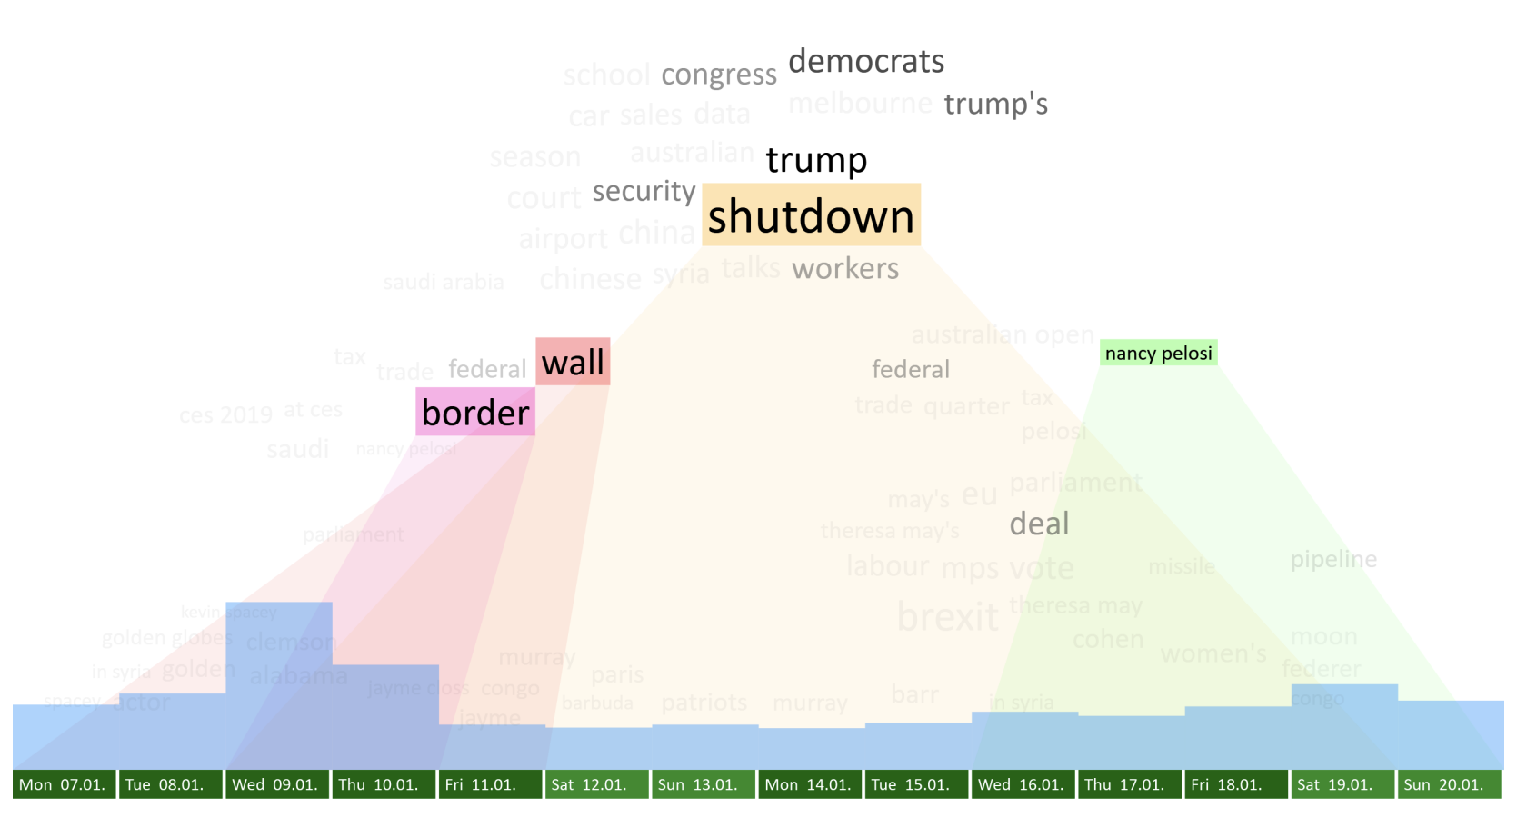
Related Work
PyramidTags
Hovering over a phase shows its timespan
Related phrases are highlighted proportional relatedness
Relatedness: two phrases tend to occur in same documents in close proximity
Knittel, J., Koch, S., & Ertl, T. 2021. PyramidTags: Context-, Time- and Word Order-Aware Tag Maps to Explore Large Document Collections. IEEE Transactions on Visualization and Computer Graphics.

Slide 23
Dispersion
Some terms are highly specific to particular type of movies. Tend to appear clumped in reviews for particular movies.
From low to high frequency: movie names, actors, and genres
Some terms tend to be appear at a roughly consistent rate in different sections of a corpus.
Are not specific to a particular type of movie.
The words “audience” or “quite” in movie reviews.
Function words (we’d think)

Slide 24
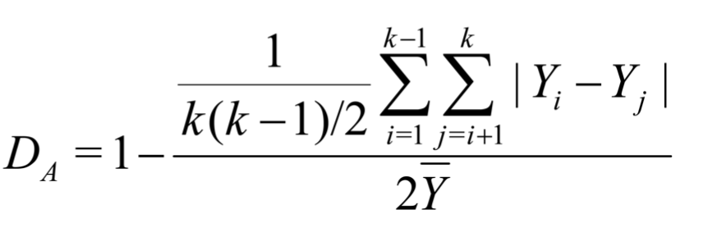
Dispersion
Measures of dispersion
Lots of metrics
Burch’s DA (2017): pairwise difference of absolute deviations.
Assumes roughly equal sized parts
Range: [0, 1] (0: max dispersion)
DA = 0.5 when dispersion = thee average term frequency
Inversely correlated with term frequency
O(|parts|²) required to compute
Yi: term frequency in part i
k: # parts in corpus
Burch, B., Egbert, J., & Biber, D. 2017. Measuring and interpreting lexical dispersion in corpus linguistics. Journal of Research Design and Statistics in Linguistics and Communication Science

Slide 25
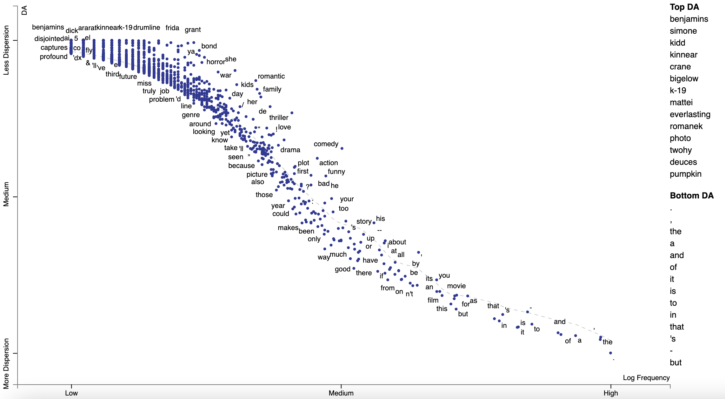
Dispersion in Movie Corpus
Note the faint dotted LOWESS
curve
Distance from curve is a marker of usually dispersed or concentrated terms
“Comedy” vs “good”
Top DA: movie names, actors and directors

Slide 26
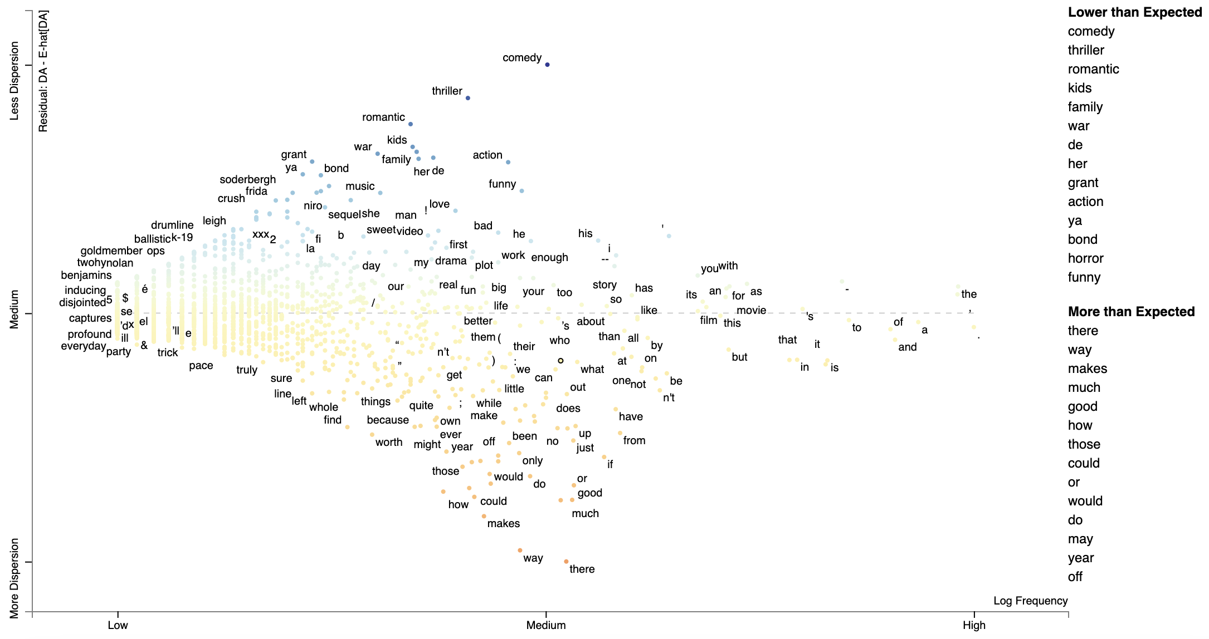
Residual Dispersion
Y-axis now vertical distance from LOWESS Curve
DA - ELOWESS[DA]
Note that some stop words and characters are usually concentrated

Slide 27
ACL Paper Title Corpus
10,974 long ACL/EMNLP paper titles from 1979 to 2022
Objective: see changes in the field of NLP
Consider year published as category

Slide 28
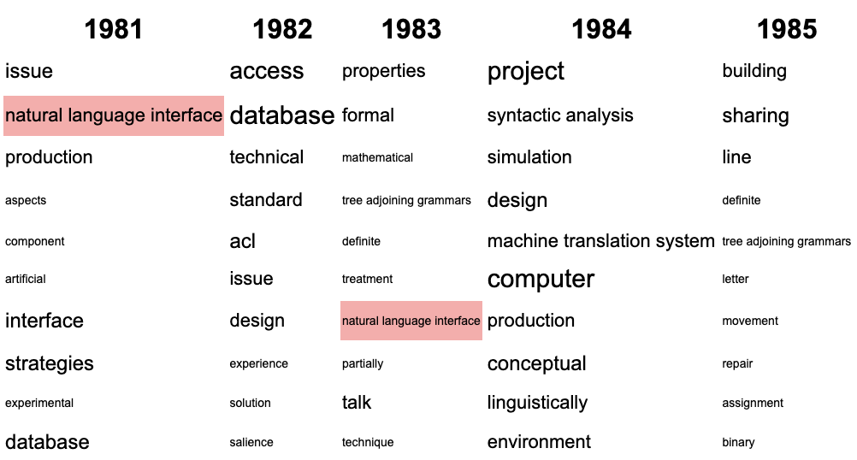
Visualizing Over Time
We can make visualization similar to parallel tag clouds
Ordered by keyness (log-odds-ratio)
Size frequency in category (globally scaled)
Too many years to view without scrolling

Slide 29
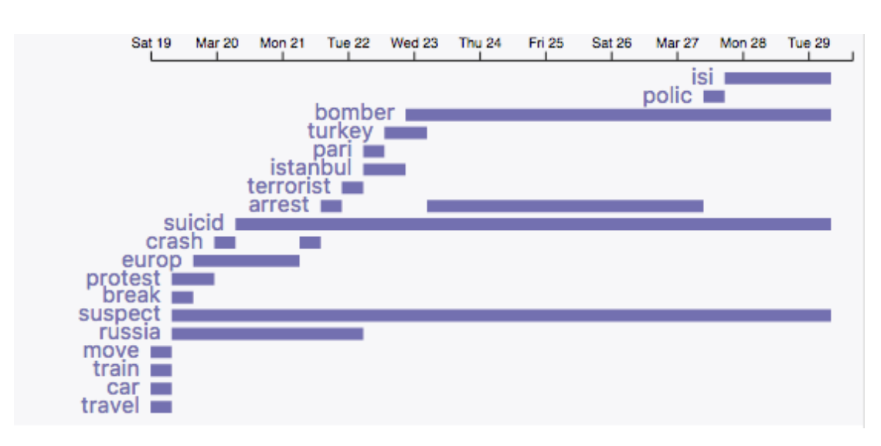
Related Work
ESTEEM
Uses a Gantt chart to display words with similar embeddings to a query
Embeddings are produced at each time step
Simple, easy-to-follow visualization
Few terms can be visualized this way
Stemmed words with similar day-specific embeddings to “bomb” from German Tweets after the 2016 Brussels terrorist attack
Dustin Arendt and Svitlana Volkova. 2017. ESTEEM: A Novel Framework for Qualitatively Evaluating and Visualizing Spatiotemporal Embeddings in Social Media. In Proceedings of ACL 2017, System Demonstrations.

Slide 30
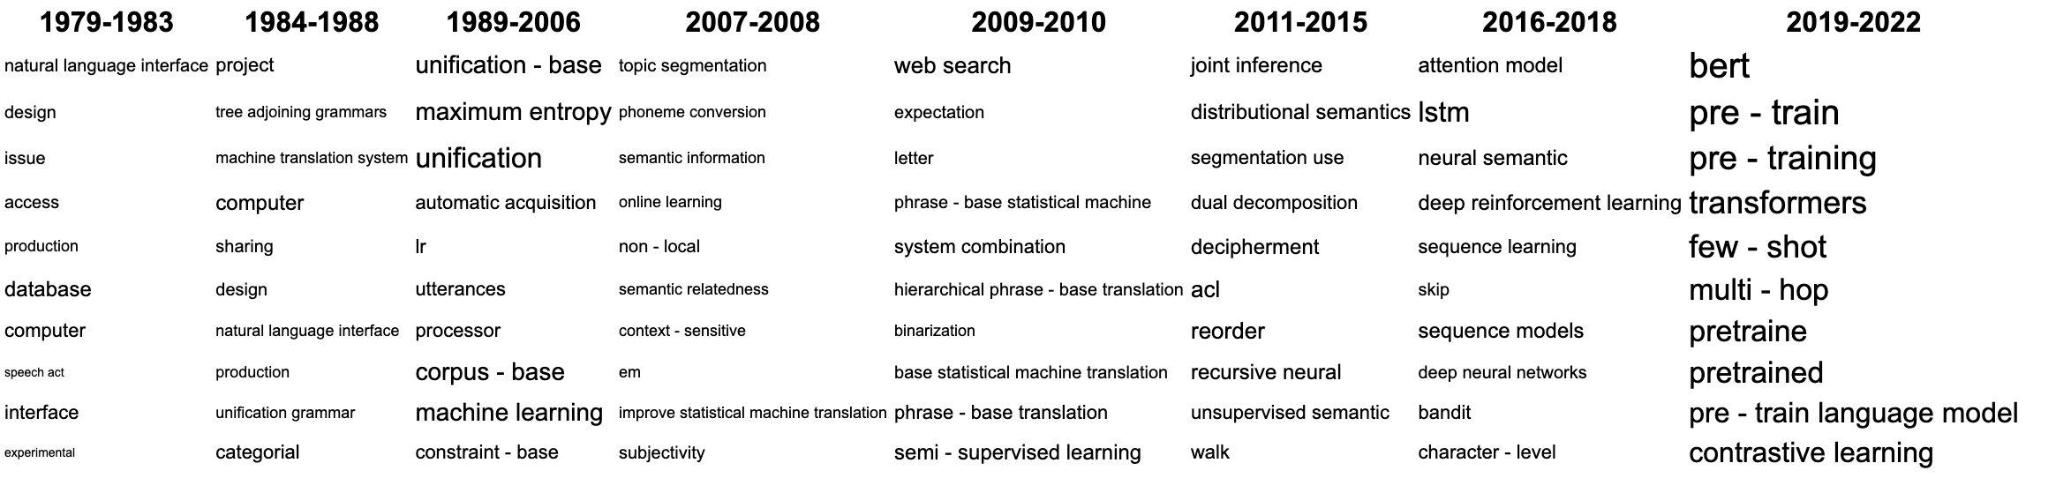
Visualizing Over Time
Solve scrolling problem: merge years together with high cosine similarity of keyness values of displayed terms

Slide 31
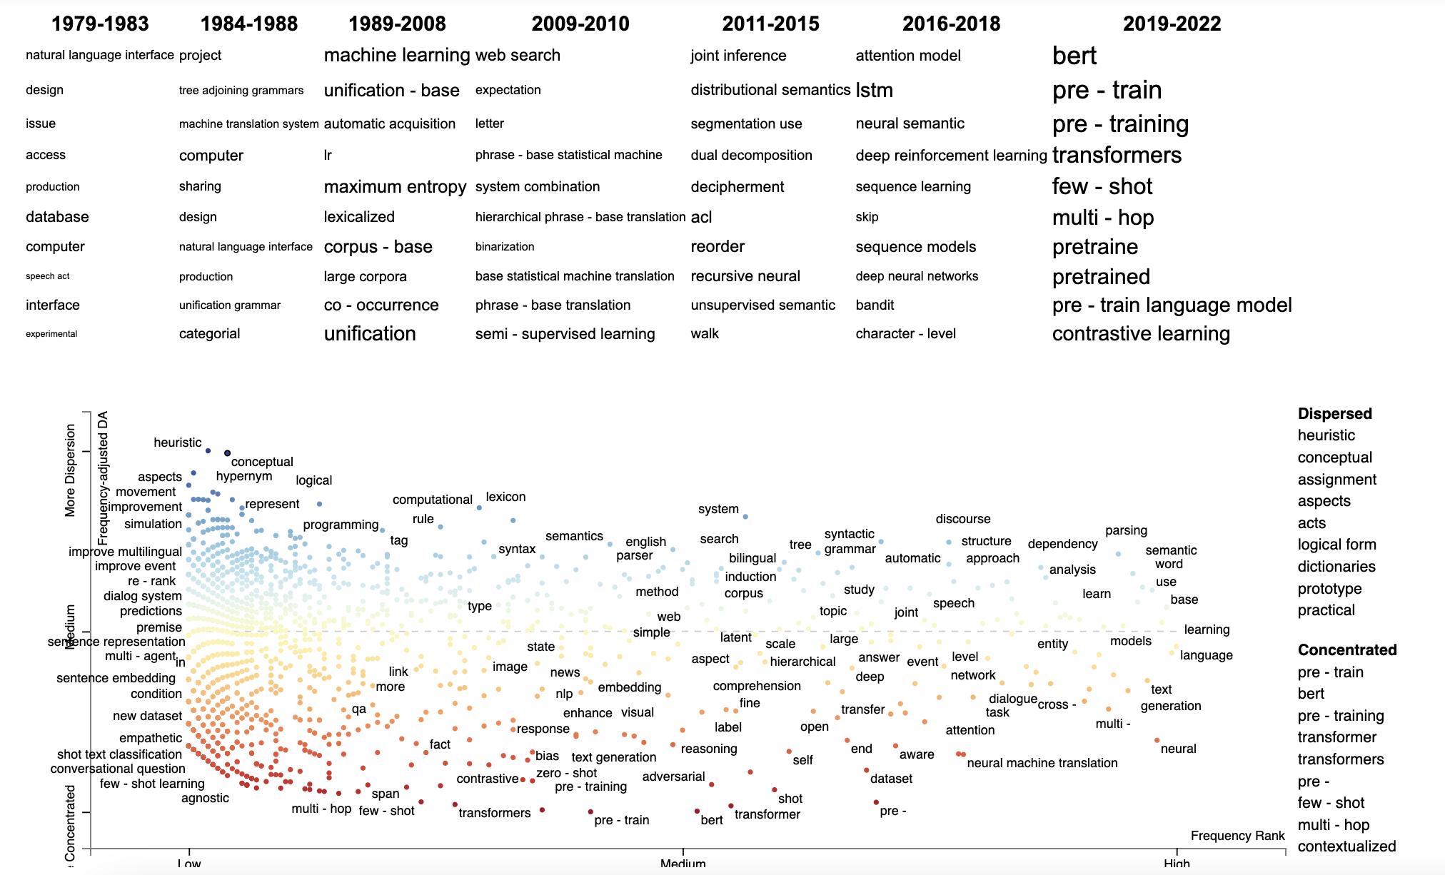
Use residual dispersion to see interesting terms which do not make the tag clouds

